Slide 1
Heisenberg Ladder: Onset of Diffusion
Kevin Wang, Joel Moore

Slide 2
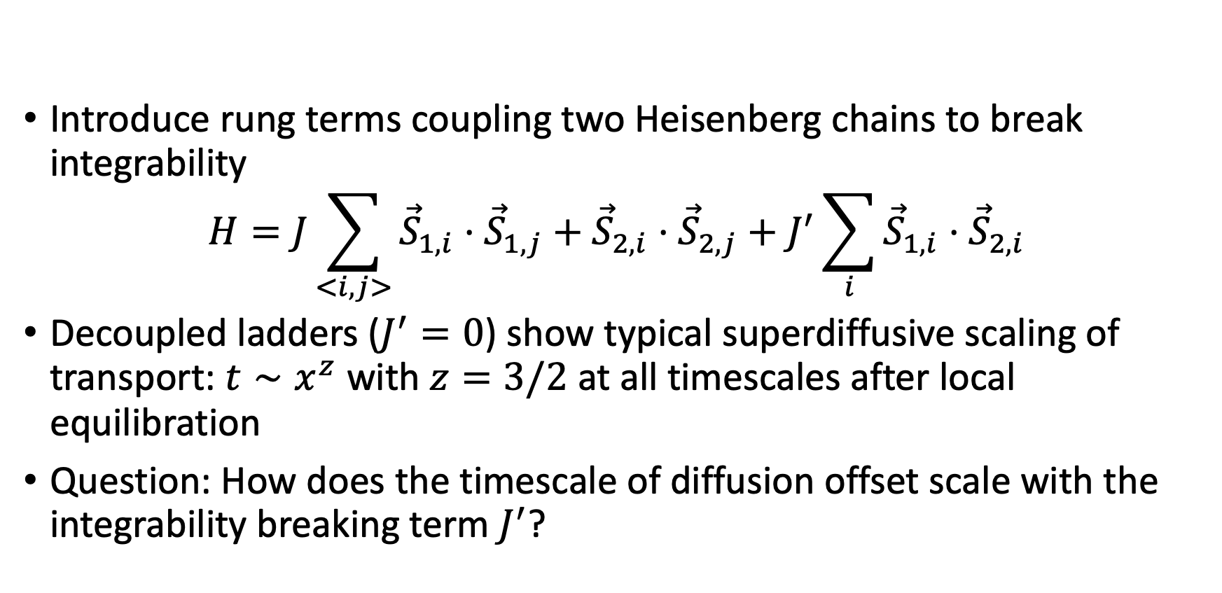
Heisenberg ladder
Introduce rung terms coupling two Heisenberg chains to break integrability
$$H=J\sum_{<i,j>}{{\vec{S}}_{1,i}}⋅{\vec{S}}_{1,j}+{\vec{S}}_{2,i}⋅{\vec{S}}_{2,j}+J^{′}\sum_{i}{{\vec{S}}_{1,i}⋅{\vec{S}}_{2,i}}$$
Decoupled ladders ($J^{′}=0$) show typical superdiffusive scaling of transport: $t∼x^{z}$ with $z=3/2$ at all timescales after local equilibration
Question: How does the timescale of diffusion offset scale with the integrability breaking term $J^{′}$?

Slide 3
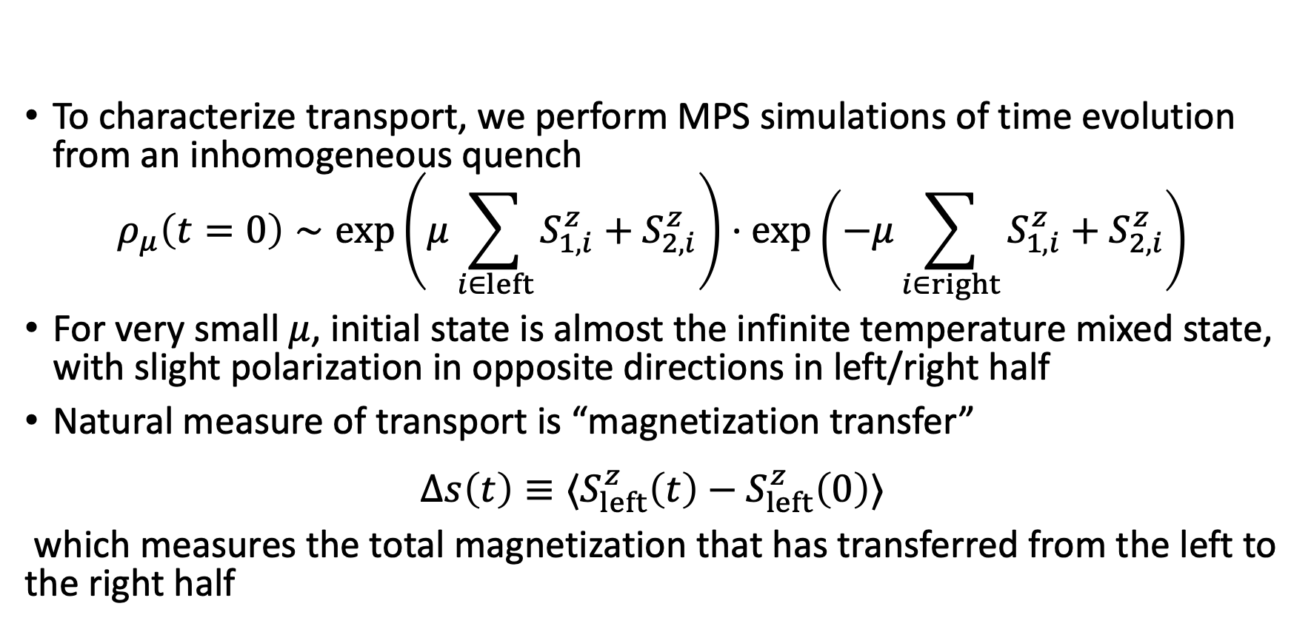
MPS Simulations
To characterize transport, we perform MPS simulations of time evolution from an inhomogeneous quench
$$ρ_{μ}\left(t=0\right)∼\exp\left(μ\sum_{i∈left}{{S_{1,i}^{z}+S}_{2,i}^{z}}\right)⋅\exp\left(−μ\sum_{i∈right}{{S_{1,i}^{z}+S}_{2,i}^{z}}\right)$$
For very small $μ$, initial state is almost the infinite temperature mixed state, with slight polarization in opposite directions in left/right half
Natural measure of transport is “magnetization transfer”
$$Δs\left(t\right)≡⟨S_{left}^{z}\left(t\right)−S_{left}^{z}\left(0\right)⟩$$
which measures the total magnetization that has transferred from the left to the right half

Slide 4
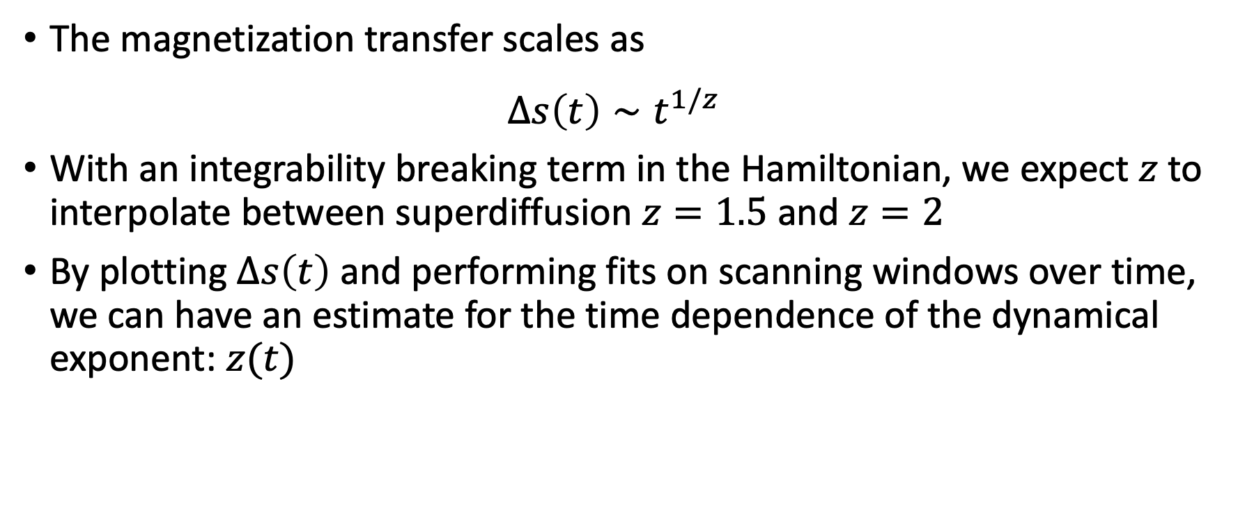
MPS Simulations
The magnetization transfer scales as
$$Δs\left(t\right)∼t^{1/z}$$
With an integrability breaking term in the Hamiltonian, we expect $z$to interpolate between superdiffusion $z=1.5$ and $z=2$
By plotting $Δs\left(t\right)$ and performing fits on scanning windows over time, we can have an estimate for the time dependence of the dynamical exponent: $z(t)$

Slide 5
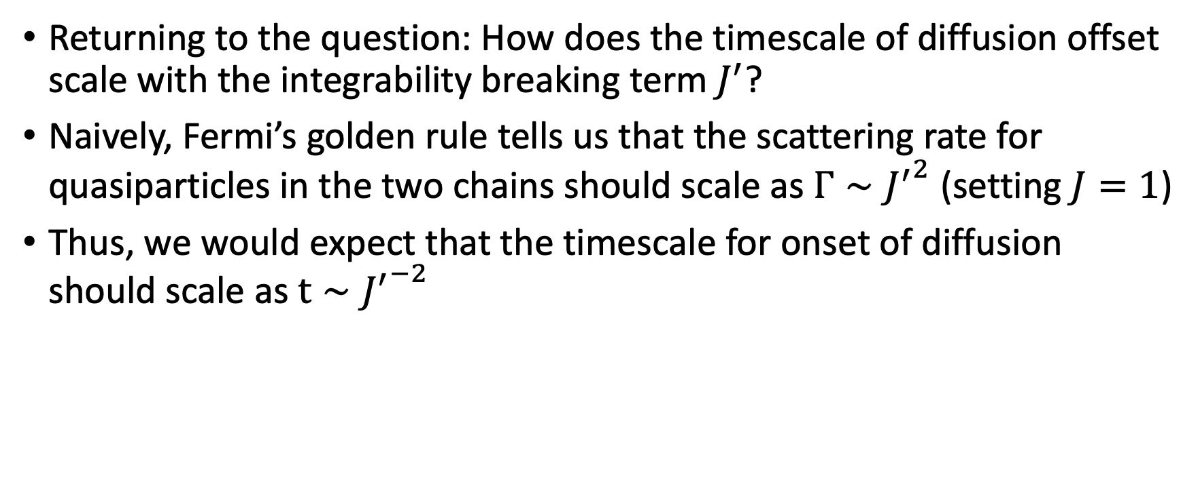
Fermi’s Golden Rule
Returning to the question: How does the timescale of diffusion offset scale with the integrability breaking term $J^{′}$?
Naively, Fermi’s golden rule tells us that the scattering rate for quasiparticles in the two chains should scale as $Γ∼{J^{′}}^{2}$ (setting $J=1$)
Thus, we would expect that the timescale for onset of diffusion should scale as $t∼{J^{′}}^{−2}$

Slide 6

Plotting $Δs(t)$ and $z(t)$ from MPS simulations

Slide 7
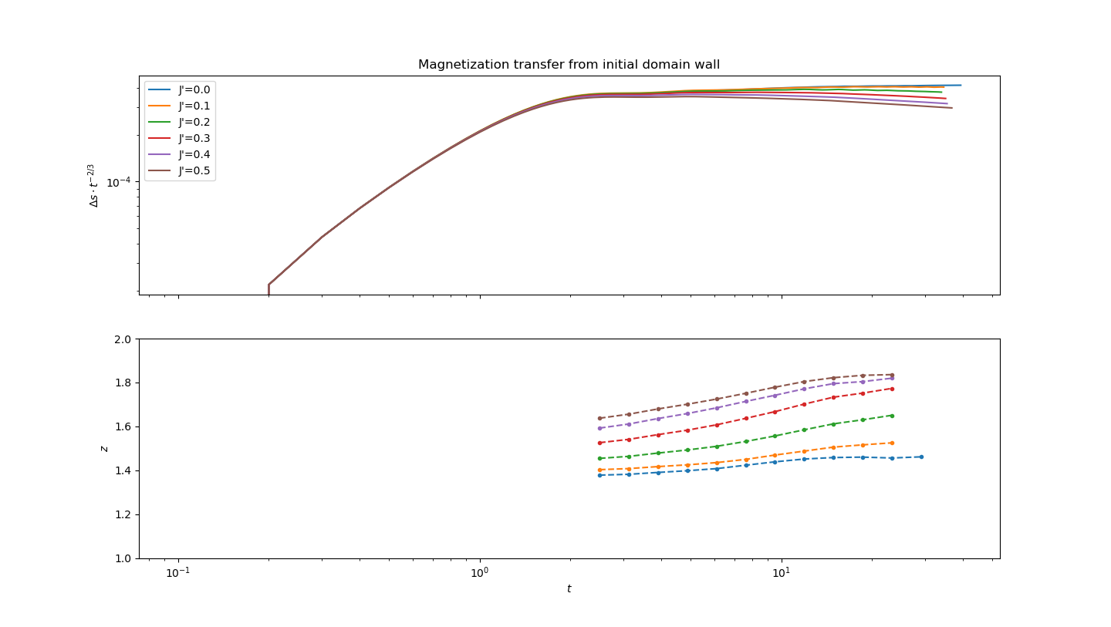

Slide 8

Rescaling time by ${J^{′}}^{2}$

Slide 9
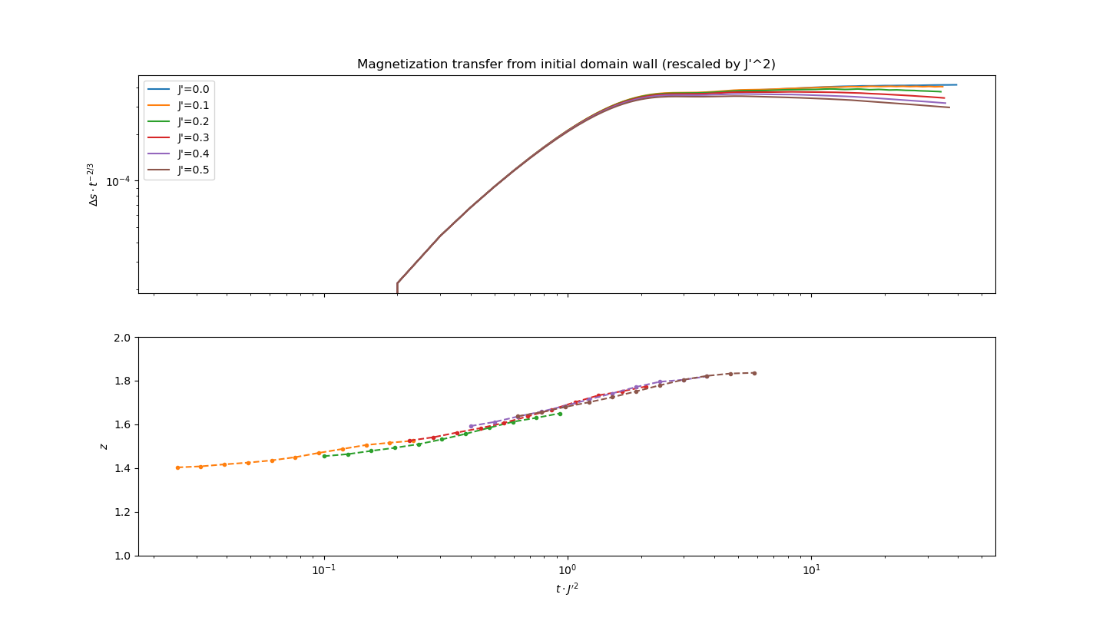

Slide 10
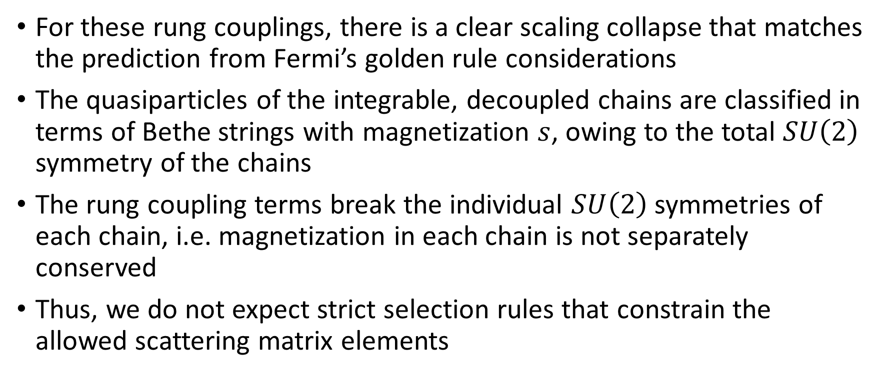
Fermi’s Golden Rule
For these rung couplings, there is a clear scaling collapse that matches the prediction from Fermi’s golden rule considerations
The quasiparticles of the integrable, decoupled chains are classified in terms of Bethe strings with magnetization $s$, owing to the total $SU\left(2\right)$ symmetry of the chains
The rung coupling terms break the individual $SU\left(2\right)$ symmetries of each chain, i.e. magnetization in each chain is not separately conserved
Thus, we do not expect strict selection rules that constrain the allowed scattering matrix elements

Slide 11
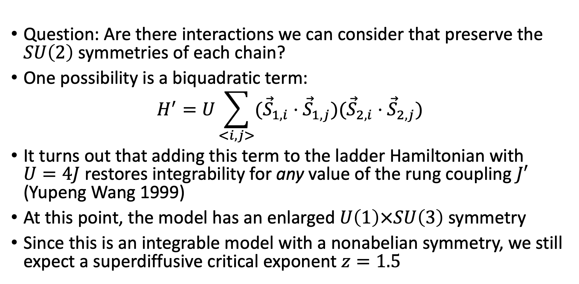
Other Perturbations
Question: Are there interactions we can consider that preserve the $SU\left(2\right)$ symmetries of each chain?
One possibility is a biquadratic term:
$$H^{′}=U\sum_{<i,j>}{({\vec{S}}_{1,i}⋅{\vec{S}}_{1,j})({\vec{S}}_{2,i}⋅{\vec{S}}_{2,j})}$$
It turns out that adding this term to the ladder Hamiltonian with $U=4J$ restores integrability for any value of the rung coupling $J′$ (Yupeng Wang 1999)
At this point, the model has an enlarged $U\left(1\right)×SU\left(3\right)$ symmetry
Since this is an integrable model with a nonabelian symmetry, we still expect a superdiffusive critical exponent $z=1.5$

Slide 12
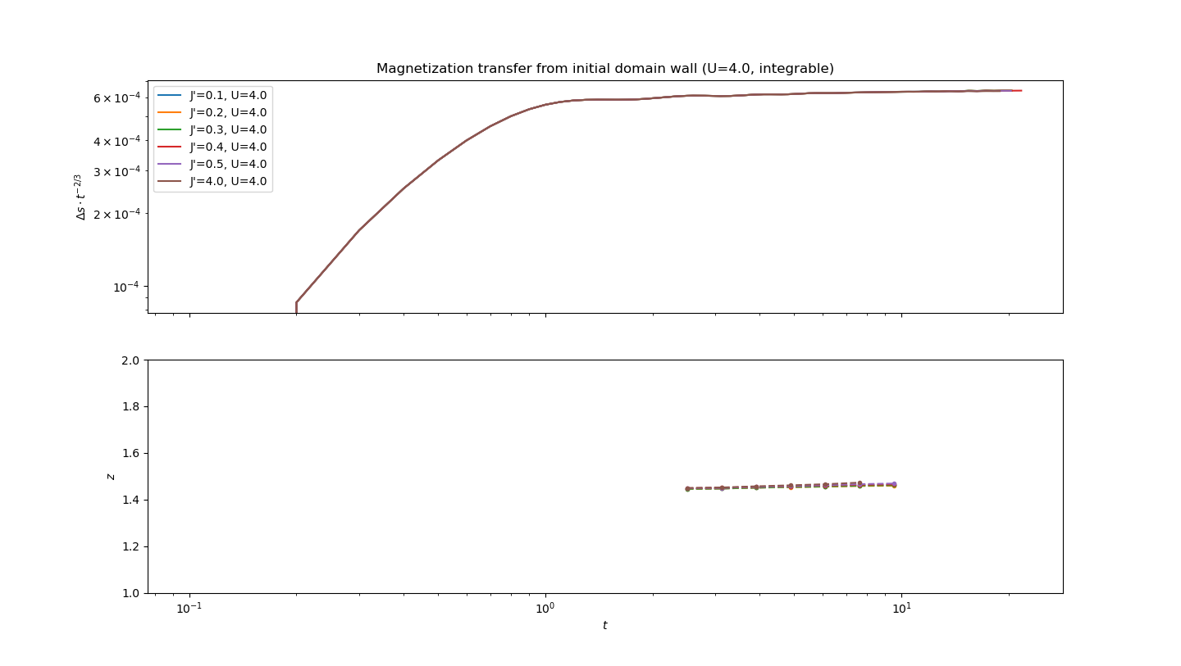

Slide 13
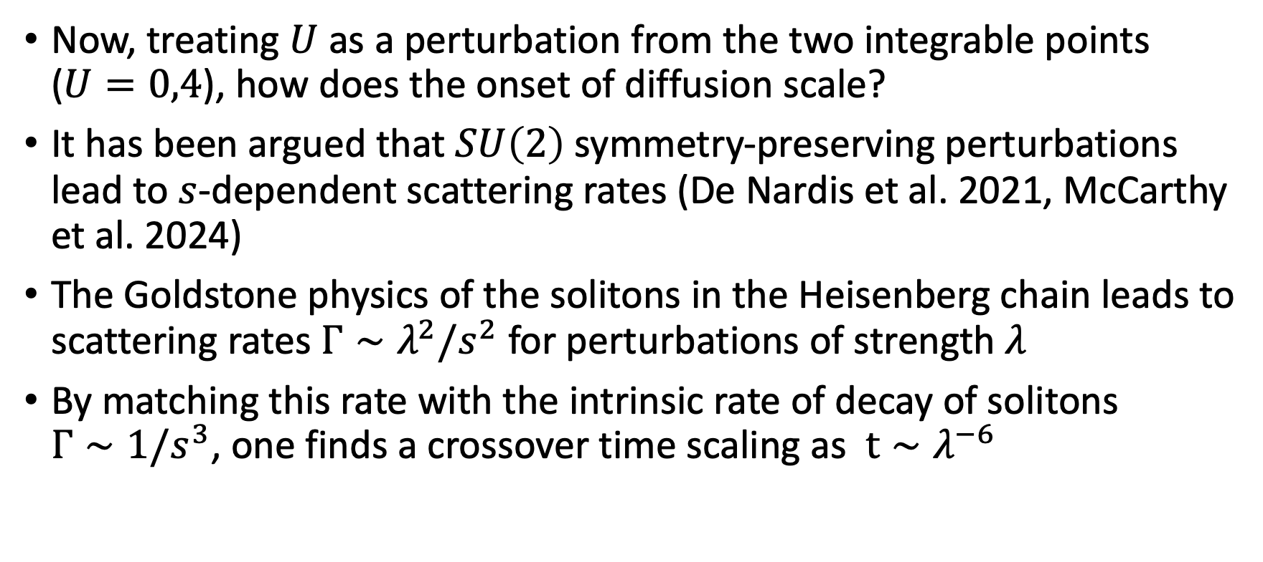
Other Perturbations
Now, treating $U$ as a perturbation from the two integrable points ($U=0,4$), how does the onset of diffusion scale?
It has been argued that $SU\left(2\right)$ symmetry-preserving perturbations lead to $s$-dependent scattering rates (De Nardis et al. 2021, McCarthy et al. 2024)
The Goldstone physics of the solitons in the Heisenberg chain leads to scattering rates $Γ∼λ^{2}/s^{2}$ for perturbations of strength $λ$
By matching this rate with the intrinsic rate of decay of solitons $Γ∼1/s^{3}$, one finds a crossover time scaling as $t∼λ^{−6}$

Slide 14
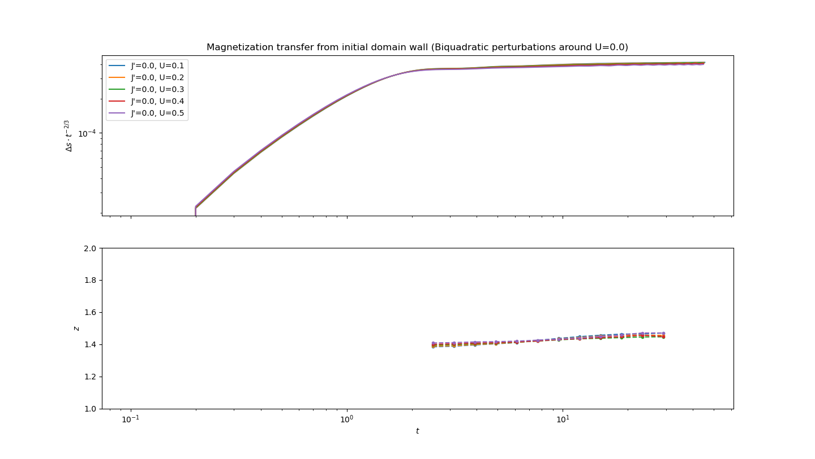

Slide 15
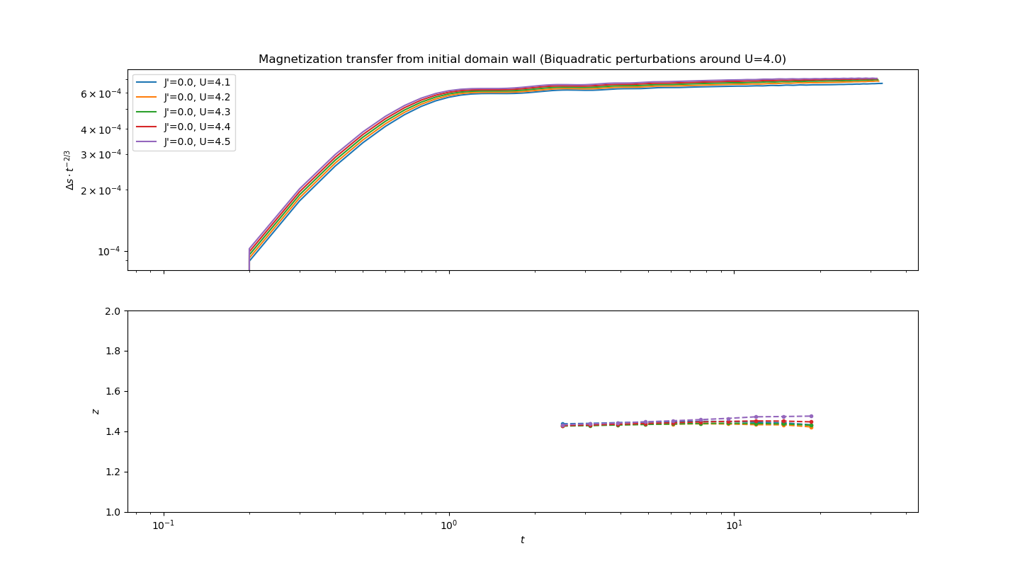

Slide 16

Other Perturbations
These timescales are difficult to access with state-of-the-art MPS techniques
Qualitatively however, one clearly sees that superdiffusion is preserved for much longer timescales as compared to $SU\left(2\right)$symmetry-breaking perturbations

Slide 17
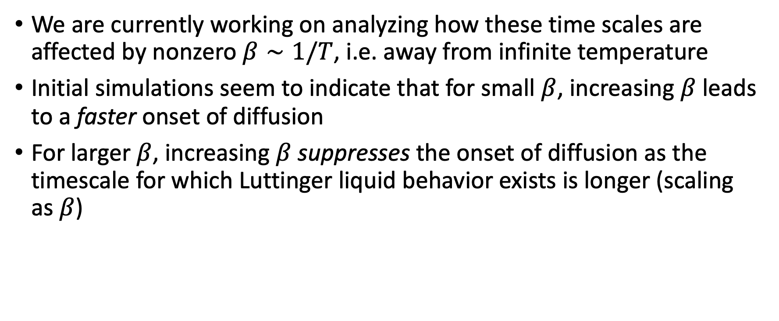
TODO
We are currently working on analyzing how these time scales are affected by nonzero $β∼1/T$, i.e. away from infinite temperature
Initial simulations seem to indicate that for small $β$, increasing $β$ leads to a faster onset of diffusion
For larger $β$, increasing $β$ suppresses the onset of diffusion as the timescale for which Luttinger liquid behavior exists is longer (scaling as $β$)

